Slide 1
Simulation results

Slide 2
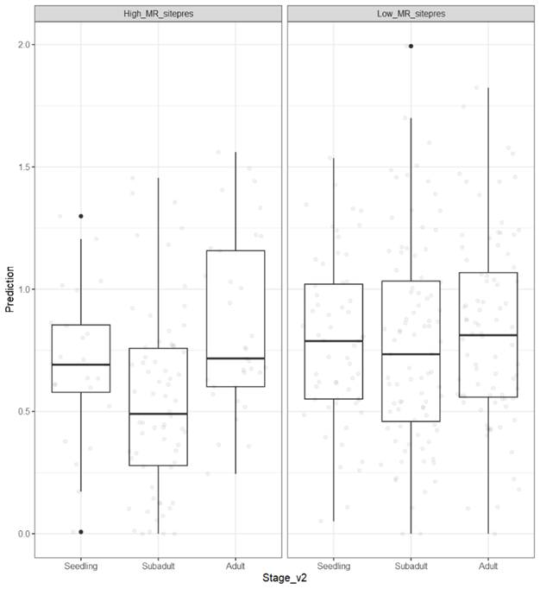
Ground truth – DArT data

Slide 3
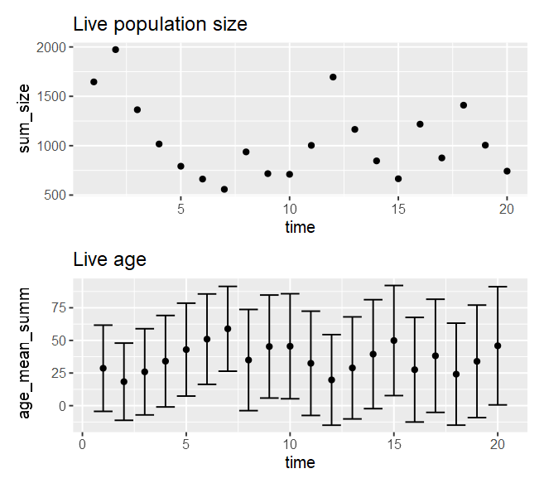
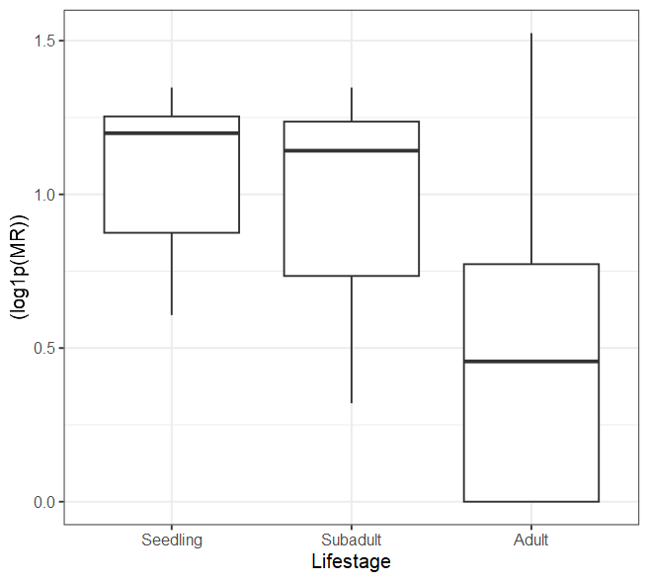
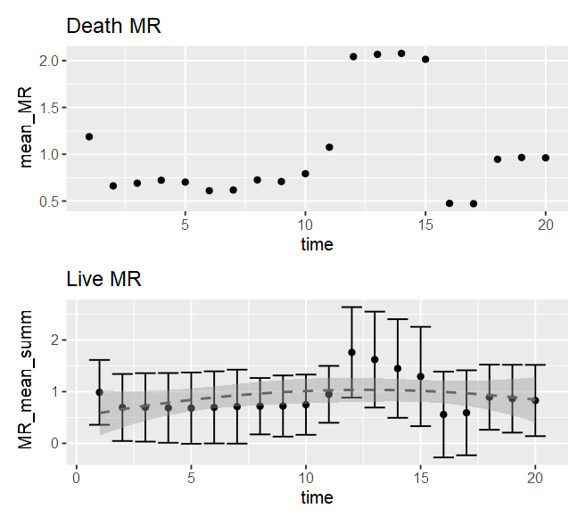
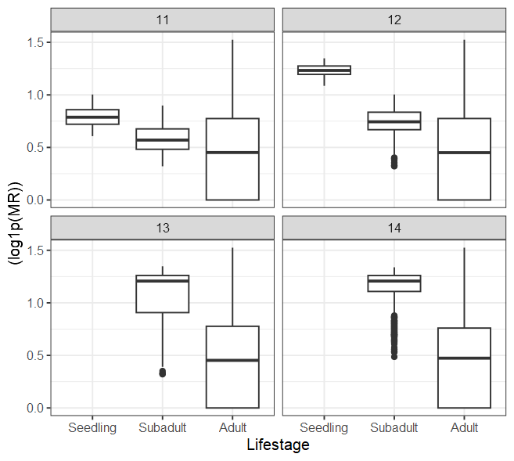
No MR toggles
## Input parameters
## Population parameters
population_size = 1000
population_carrying_capacity = 3000 # If population creeps above this value, comp is used to punish the population size by increasing the minimum probability of death based on how much higher population size is than the carrying capacity
population_minimum_size = 500 # If population falls below this value, there is a 10x increased chance of recruitment
MR_mean = 0.5 # out of 1
MR_sd = 1
disturbance_chance=0 # chance of a disturbance, increases death and recruitment rate by disturbance_impact
disturbance_impact_val=5 # impacts base age & MR death factor and recruitment constant
## Parameters
age_impact = 0.2 # scaled age inflicted increase
mortality_age_shift = 100 # at what age does increases in age increase chance of death
MR_imp = F # toggle on/off for MR inflicted death increase
MR_death_impact = 0.5 # linear scaled MR inflicted death increase - scales with comp + age impact value
MR_age_impact = 10 # scaled impact of age (value / age) on MR inflicted death increase
MR_recruit_imp = F # toggle on/off of MR affect on recruitment
MR_recruit_impact = 0.05 # impact of MR on recruitment, a multiplier of the individual MR to reduce recruitment chance
comp_imp = T # toggle on/off for competition due to carrying capacity
comp_impact = 1 # impact of competition due to carrying capacity
## Recruitment parameters
recruitment_const = 0.001 # base constant for chance of recruitment
recruitment_age = 7 # age to begin recruiting
recruitment_mean = 1000 # mean for PDF of normal distribution for number of recruited individuals
recruitment_sd = recruitment_mean/2 # standard deviation of number of recruited individuals
## Simulation parameters
time_max = 20 # how long to run sim for
output_timept = 100 # How often to report visual statistics
timepoint_pop_grab = seq(2:15) # Saves population at the end of the timepoints (post-recruitment + mortality events) - note time will be +1 than indicated as it is past incident events - saved in object pop_timepoints (list of lists)

Slide 4
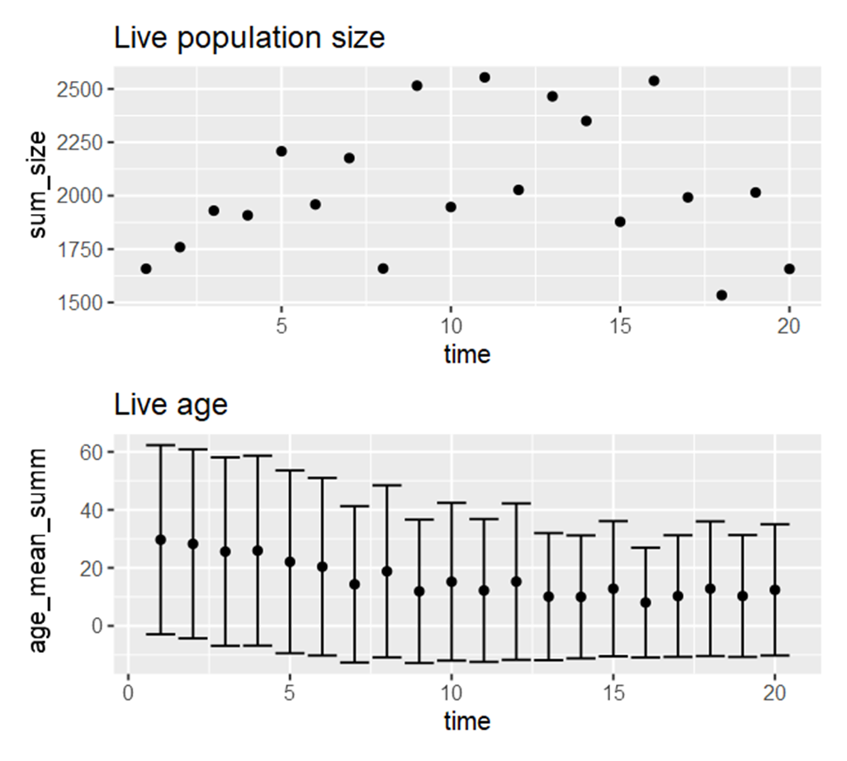
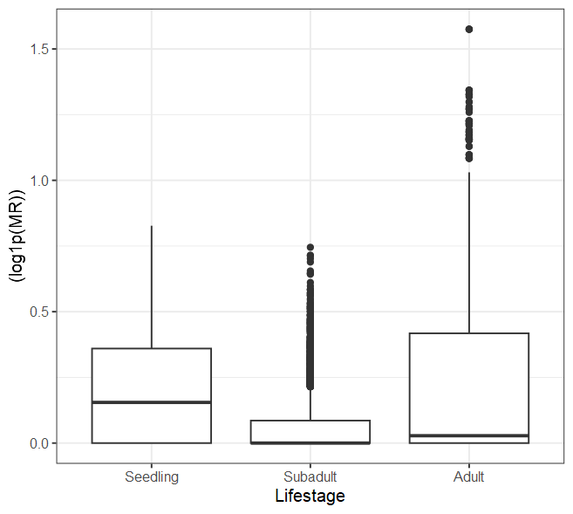
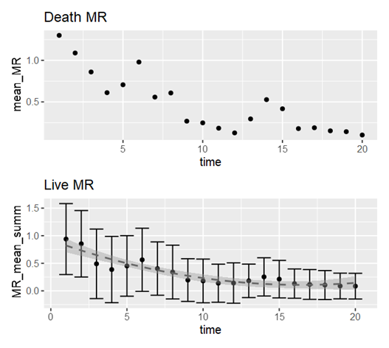
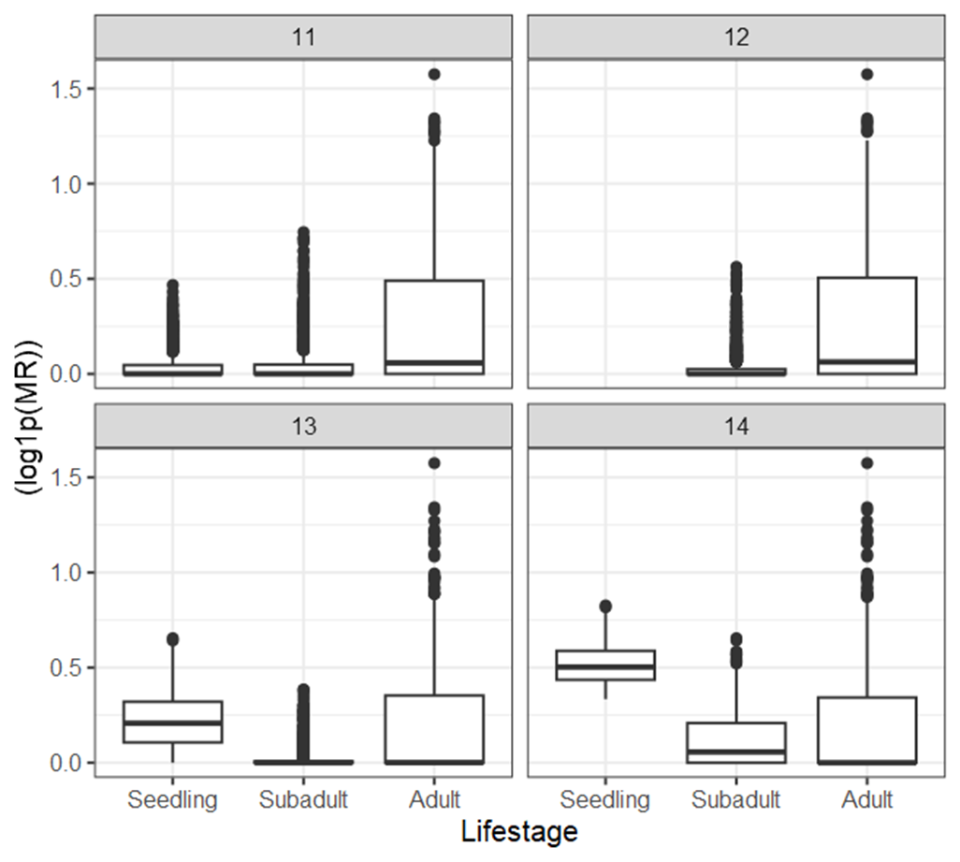
MR toggles - mod
## Input parameters
## Population parameters
population_size = 1000
population_carrying_capacity = 3000 # If population creeps above this value, comp is used to punish the population size by increasing the minimum probability of death based on how much higher population size is than the carrying capacity
population_minimum_size = 500 # If population falls below this value, there is a 10x increased chance of recruitment
MR_mean = 0.5 # out of 1
MR_sd = 1
disturbance_chance=0 # chance of a disturbance, increases death and recruitment rate by disturbance_impact
disturbance_impact_val=5 # impacts base age & MR death factor and recruitment constant
## Parameters
age_impact = 0.2 # scaled age inflicted increase
mortality_age_shift = 100 # at what age does increases in age increase chance of death
MR_imp = T # toggle on/off for MR inflicted death increase
MR_death_impact = 0.5 # linear scaled MR inflicted death increase - scales with comp + age impact value
MR_age_impact = 10 # scaled impact of age (value / age) on MR inflicted death increase
MR_recruit_imp = T # toggle on/off of MR affect on recruitment
MR_recruit_impact = 0.05 # impact of MR on recruitment, a multiplier of the individual MR to reduce recruitment chance
comp_imp = T # toggle on/off for competition due to carrying capacity
comp_impact = 1 # impact of competition due to carrying capacity
## Recruitment parameters
recruitment_const = 0.001 # base constant for chance of recruitment
recruitment_age = 7 # age to begin recruiting
recruitment_mean = 1000 # mean for PDF of normal distribution for number of recruited individuals
recruitment_sd = recruitment_mean/2 # standard deviation of number of recruited individuals
## Simulation parameters
time_max = 20 # how long to run sim for
output_timept = 100 # How often to report visual statistics
timepoint_pop_grab = seq(2:15) # Saves population at the end of the timepoints (post-recruitment + mortality events) - note time will be +1 than indicated as it is past incident events - saved in object pop_timepoints (list of lists)

Slide 5
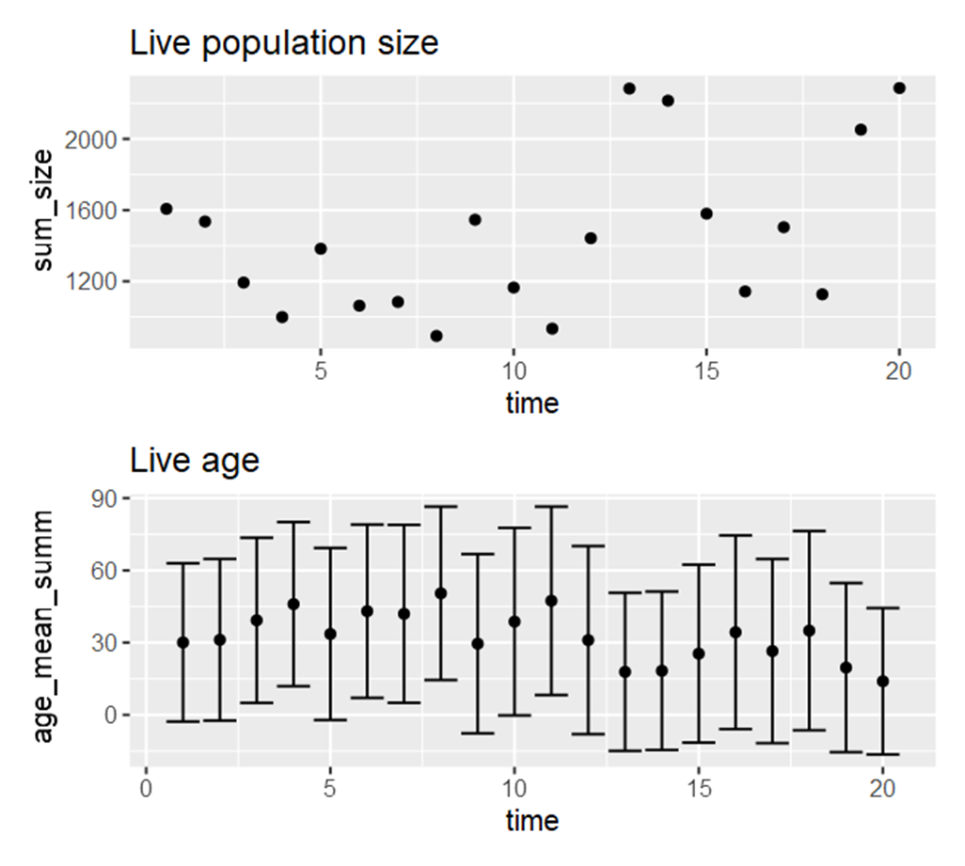
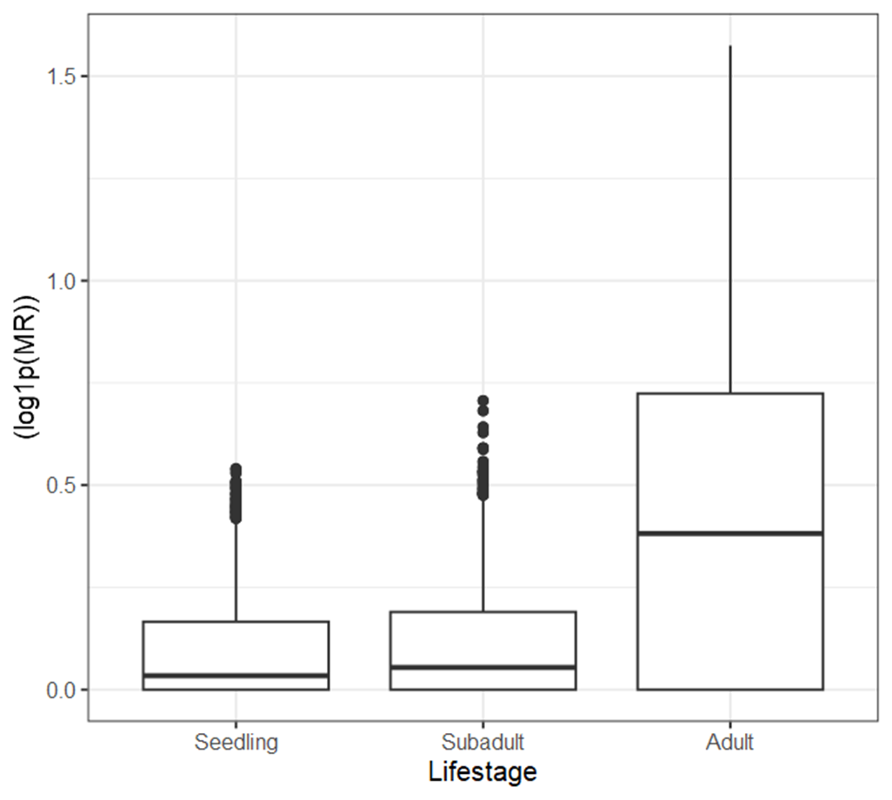
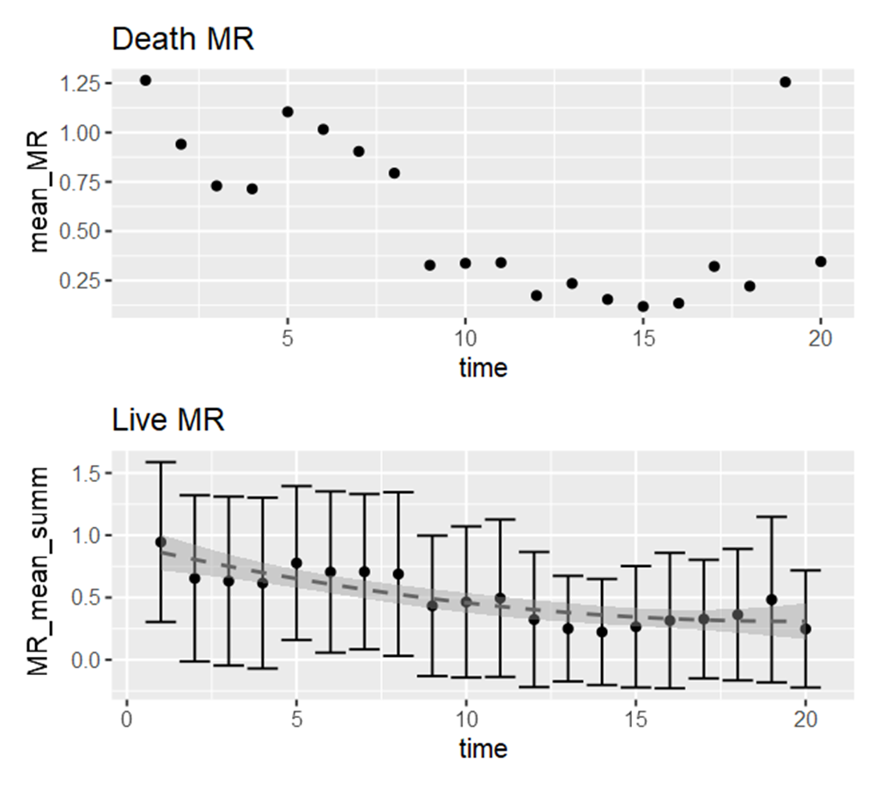
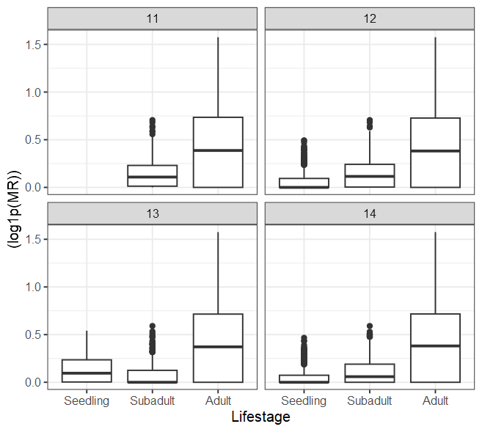
MR toggles - low
## Input parameters
## Population parameters
population_size = 1000
population_carrying_capacity = 3000 # If population creeps above this value, comp is used to punish the population size by increasing the minimum probability of death based on how much higher population size is than the carrying capacity
population_minimum_size = 500 # If population falls below this value, there is a 10x increased chance of recruitment
MR_mean = 0.5 # out of 1
MR_sd = 1
disturbance_chance=0 # chance of a disturbance, increases death and recruitment rate by disturbance_impact
disturbance_impact_val=5 # impacts base age & MR death factor and recruitment constant
## Parameters
age_impact = 0.2 # scaled age inflicted increase
mortality_age_shift = 100 # at what age does increases in age increase chance of death
MR_imp = T # toggle on/off for MR inflicted death increase
MR_death_impact = 0.1 # linear scaled MR inflicted death increase - scales with comp + age impact value
MR_age_impact = 10 # scaled impact of age (value / age) on MR inflicted death increase
MR_recruit_imp = T # toggle on/off of MR affect on recruitment
MR_recruit_impact = 0.01 # impact of MR on recruitment, a multiplier of the individual MR to reduce recruitment chance
comp_imp = T # toggle on/off for competition due to carrying capacity
comp_impact = 1 # impact of competition due to carrying capacity
## Recruitment parameters
recruitment_const = 0.001 # base constant for chance of recruitment
recruitment_age = 7 # age to begin recruiting
recruitment_mean = 1000 # mean for PDF of normal distribution for number of recruited individuals
recruitment_sd = recruitment_mean/2 # standard deviation of number of recruited individuals
## Simulation parameters
time_max = 20 # how long to run sim for
output_timept = 100 # How often to report visual statistics
timepoint_pop_grab = seq(2:15) # Saves population at the end of the timepoints (post-recruitment + mortality events) - note time will be +1 than indicated as it is past incident events - saved in object pop_timepoints (list of lists)

Slide 6
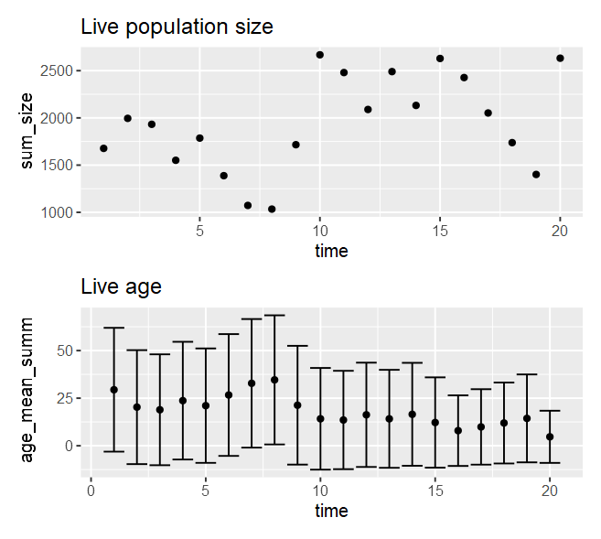
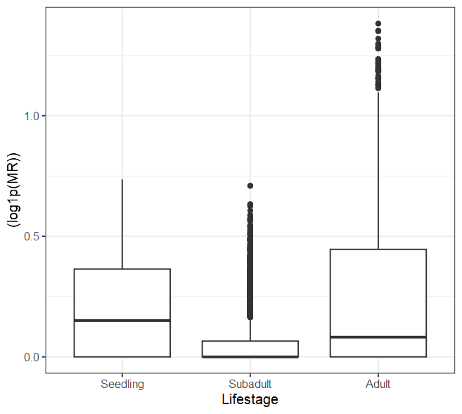
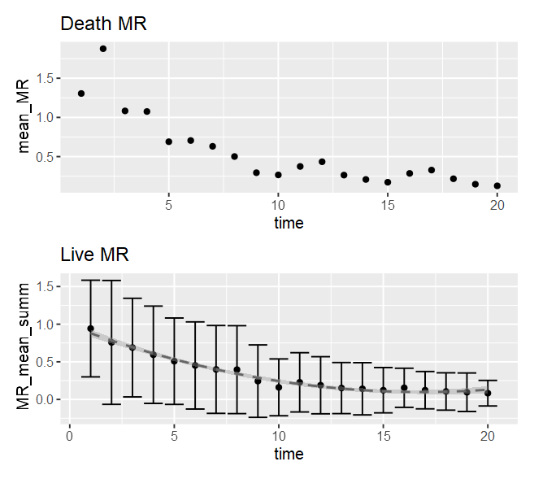
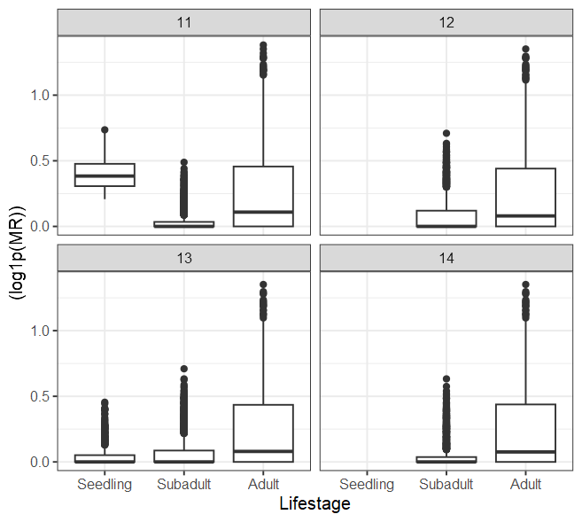
MR toggles - high
## Input parameters
## Population parameters
population_size = 1000
population_carrying_capacity = 3000 # If population creeps above this value, comp is used to punish the population size by increasing the minimum probability of death based on how much higher population size is than the carrying capacity
population_minimum_size = 500 # If population falls below this value, there is a 10x increased chance of recruitment
MR_mean = 0.5 # out of 1
MR_sd = 1
disturbance_chance=0 # chance of a disturbance, increases death and recruitment rate by disturbance_impact
disturbance_impact_val=5 # impacts base age & MR death factor and recruitment constant
## Parameters
age_impact = 0.2 # scaled age inflicted increase
mortality_age_shift = 100 # at what age does increases in age increase chance of death
MR_imp = T # toggle on/off for MR inflicted death increase
MR_death_impact = 1.0 # linear scaled MR inflicted death increase - scales with comp + age impact value
MR_age_impact = 10 # scaled impact of age (value / age) on MR inflicted death increase
MR_recruit_imp = T # toggle on/off of MR affect on recruitment
MR_recruit_impact = 0.1 # impact of MR on recruitment, a multiplier of the individual MR to reduce recruitment chance
comp_imp = T # toggle on/off for competition due to carrying capacity
comp_impact = 1 # impact of competition due to carrying capacity
## Recruitment parameters
recruitment_const = 0.001 # base constant for chance of recruitment
recruitment_age = 7 # age to begin recruiting
recruitment_mean = 1000 # mean for PDF of normal distribution for number of recruited individuals
recruitment_sd = recruitment_mean/2 # standard deviation of number of recruited individuals
## Simulation parameters
time_max = 20 # how long to run sim for
output_timept = 100 # How often to report visual statistics
timepoint_pop_grab = seq(2:15) # Saves population at the end of the timepoints (post-recruitment + mortality events) - note time will be +1 than indicated as it is past incident events - saved in object pop_timepoints (list of lists)

Slide 7
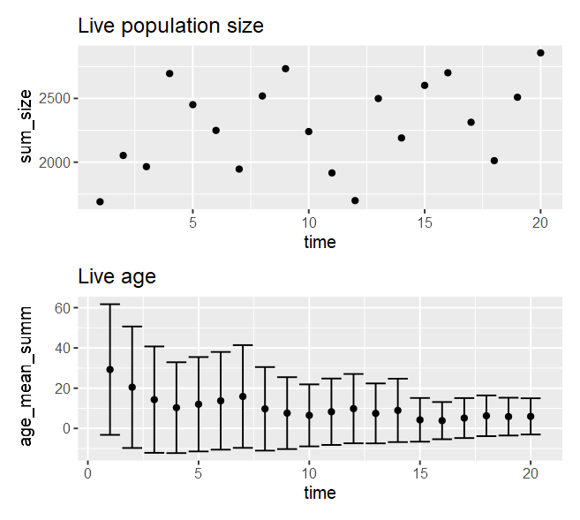
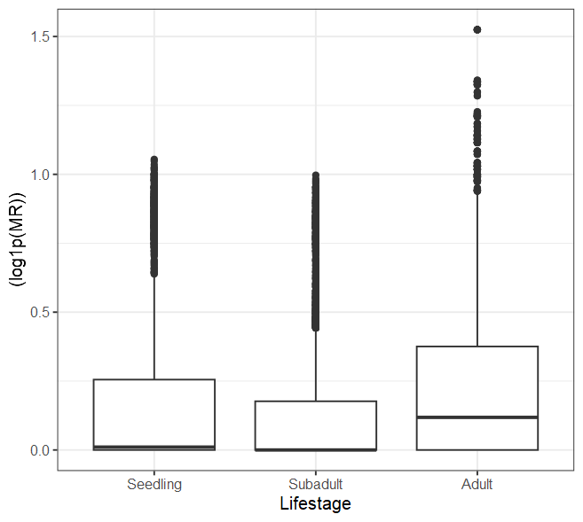
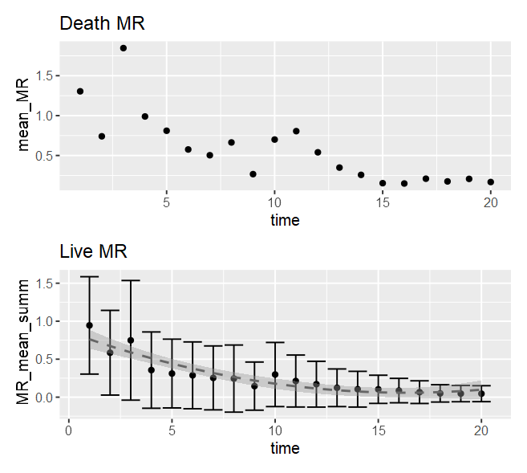
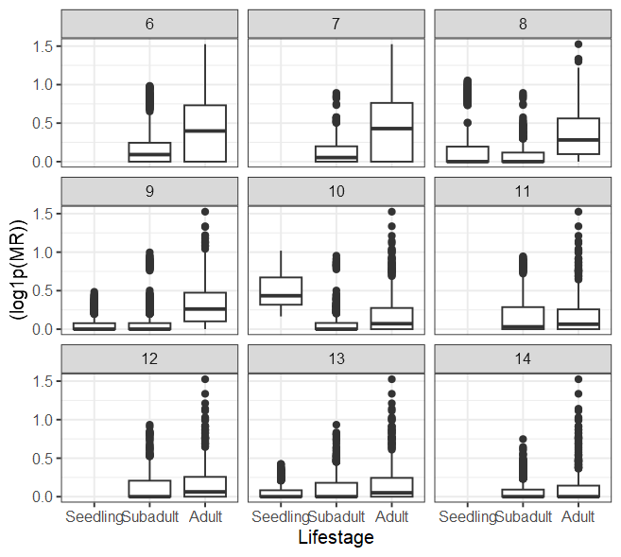
MR toggles – mod + increased seedling pressure
## Input parameters
## Population parameters
population_size = 1000
population_carrying_capacity = 3000 # If population creeps above this value, comp is used to punish the population size by increasing the minimum probability of death based on how much higher population size is than the carrying capacity
population_minimum_size = 500 # If population falls below this value, there is a 10x increased chance of recruitment
MR_mean = 0.5 # out of 1
MR_sd = 1
disturbance_chance=0 # chance of a disturbance, increases death and recruitment rate by disturbance_impact
disturbance_impact_val=5 # impacts base age & MR death factor and recruitment constant
## Parameters
age_impact = 0.2 # scaled age inflicted increase
mortality_age_shift = 100 # at what age does increases in age increase chance of death
MR_imp = T # toggle on/off for MR inflicted death increase
MR_death_impact = 0.5 # linear scaled MR inflicted death increase - scales with comp + age impact value
MR_age_impact = 50 # scaled impact of age (value / age) on MR inflicted death increase
MR_recruit_imp = T # toggle on/off of MR affect on recruitment
MR_recruit_impact = 0.05 # impact of MR on recruitment, a multiplier of the individual MR to reduce recruitment chance
comp_imp = T # toggle on/off for competition due to carrying capacity
comp_impact = 1 # impact of competition due to carrying capacity
## Recruitment parameters
recruitment_const = 0.001 # base constant for chance of recruitment
recruitment_age = 7 # age to begin recruiting
recruitment_mean = 1000 # mean for PDF of normal distribution for number of recruited individuals
recruitment_sd = recruitment_mean/2 # standard deviation of number of recruited individuals
## Simulation parameters
time_max = 20 # how long to run sim for
output_timept = 100 # How often to report visual statistics
timepoint_pop_grab = seq(2:15) # Saves population at the end of the timepoints (post-recruitment + mortality events) - note time will be +1 than indicated as it is past incident events - saved in object pop_timepoints (list of lists)

